Slide 1
Analog Transmission and Bandwidth Utilization
Course Code: COE 3201
Course Title: Data Communication
Dept. of Computer Engineering
Faculty of Engineering
Lecture No: | 8 | Week No: | 9 | Semester:
Lecturer:

Slide 2
Lecture Outline
QAM
Analog to Analog Conversion
Amplitude Modulation (AM)
Frequency Modulation (FM)
Phase Modulation (PM)
Multiplexing
Frequency-Division Multiplexing

Slide 3
QAM
PSK is limited by the ability of the equipment to distinguish small differences in phase.
This factor limits its potential bit rate.
So far, we have been altering only one of the three characteristics of a sine wave at a time; but what if we alter two? Why not combine ASK and PSK?
The idea of using two carriers, one in-phase and the other quadrature, with different amplitude levels for each carrier is the concept behind quadrature amplitude modulation (QAM).

Slide 4
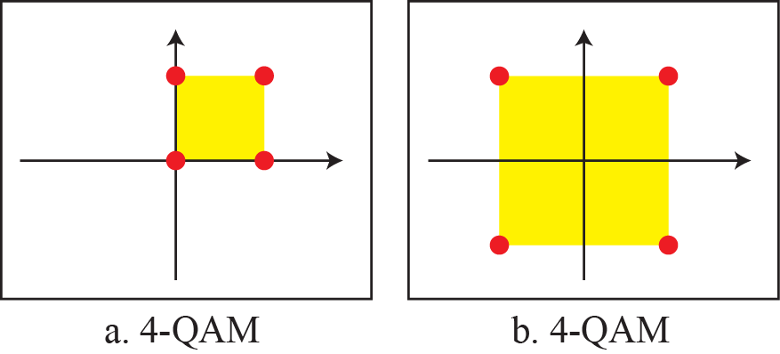
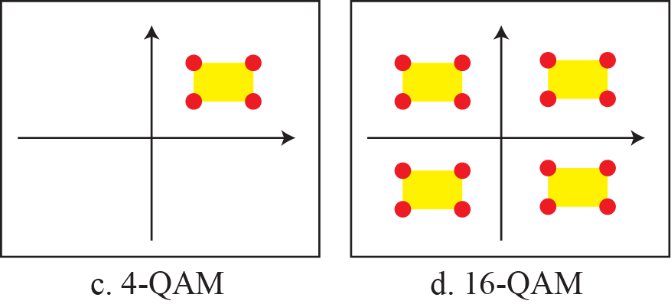
Constellation diagrams for some QAMs
Figure 5.14: Constellation diagrams for some QAMs

Slide 5
Constellation diagrams for some QAMs
Figure 5.14 shows some of these schemes. Figure 5.14a shows the simplest 4-QAM scheme using a unipolar NRZ signal to modulate each carrier. This is the same mechanism we used for ASK (OOK).
Part b shows another 4-QAM using polar NRZ, but this is the same as QPSK.

Slide 6
Constellation diagrams for some QAMs
Part c shows another QAM-4 in which we used a signal with two positive levels to modulate each of the two carriers.
Finally, Figure 5.14d shows a 16-QAM constellation of a signal with eight levels, four positive and four negative.

Slide 7
Analog to Analog Conversion
Analog-to-analog conversion, or analog modulation, is the representation of analog information by an analog signal. One may ask why we need to modulate an analog signal; it is already analog. Modulation is needed if the medium is bandpass in nature or if only a bandpass channel is available to us. Analog-to-analog conversion can be accomplished in three ways: AM FM and PM.

Slide 8
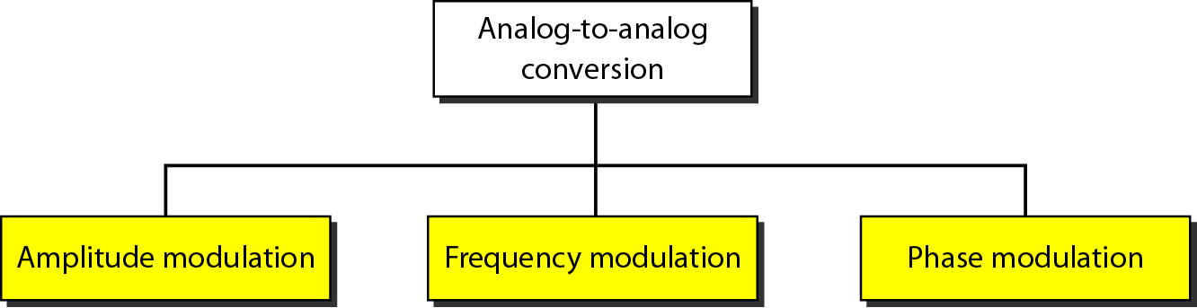
Analog to Analog Conversion
Figure 5.15: Types of analog-to-analog modulation

Slide 9
Amplitude Modulation (AM)
In AM transmission, the carrier signal is modulated so that its amplitude varies with the changing amplitudes of the modulating signal.
The frequency and phase of the carrier remain the same; only the amplitude changes to follow variations in the information.
Figure 5.16 shows how this concept works.
The modulating signal is the envelope of the carrier.

Slide 10
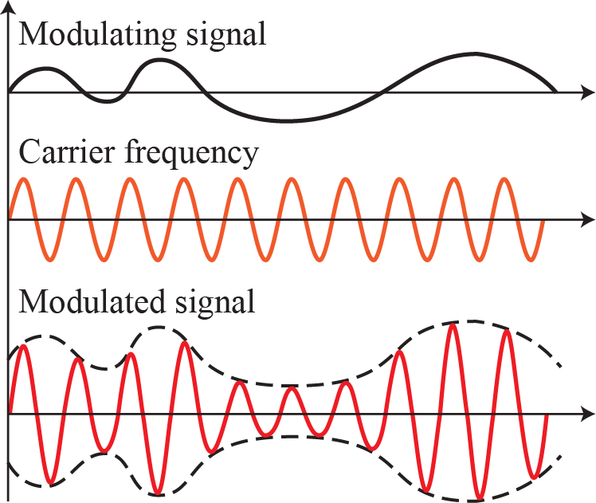
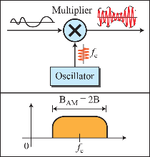
Amplitude Modulation (AM)
As Figure 5.16 shows, AM is normally implemented by using a simple multiplier because the amplitude of the carrier signal needs to be changed according to the amplitude of the modulating signal.
Figure 5.16: Amplitude modulation

Slide 11
Amplitude Modulation (AM)
An increase in the amplitude of the modulating signal causes the amplitude of the carrier to increase.
An increase or a decrease in the amplitude of the modulating signal causes a corresponding increase or decrease in both the positive and the negative peaks of the carrier amplitude.
An imaginary line connecting the positive peaks and negative peaks of the carrier waveform (the dashed line in the figure) gives the exact shape of the modulating information signal.
This imaginary line on the carrier waveform is known as the envelope.

Slide 12
Frequency Modulation (FM)
In FM transmission, the frequency of the carrier signal is modulated to follow the changing voltage level (amplitude) of the modulating signal.
The peak amplitude and phase of the carrier signal remain constant, but as the amplitude of the information signal changes, the frequency of the carrier changes correspondingly.
Figure 5.18 shows the relationships of the modulating signal, the carrier signal, and the resultant FM signal.
Figure 5.16: Amplitude modulation

Slide 13
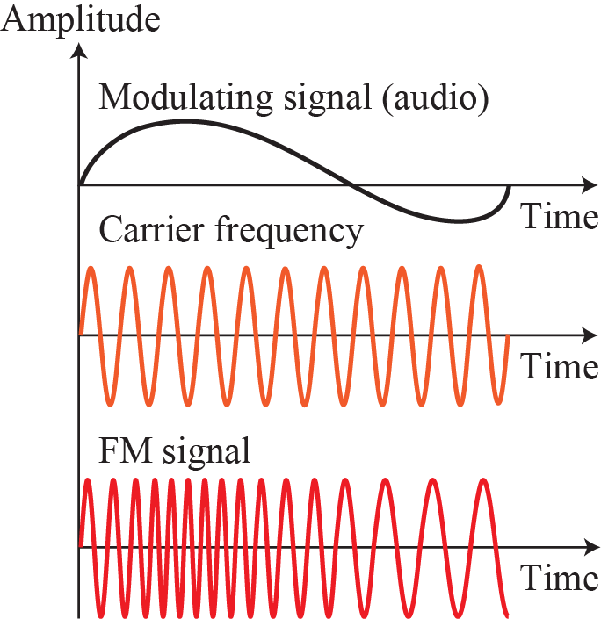
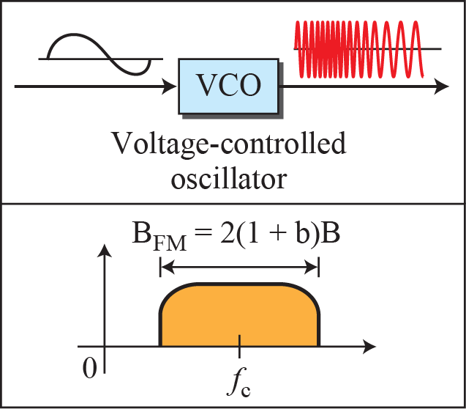
Frequency Modulation (FM)
Figure 5.18: Frequency modulation

Slide 14
Phase Modulation (PM)
In PM transmission, the phase of the carrier signal is modulated to follow the changing voltage level (amplitude) of the modulating signal.
The peak amplitude and frequency of the carrier signal remain constant, but as the amplitude of the information signal changes, the phase of the carrier changes correspondingly.

Slide 15
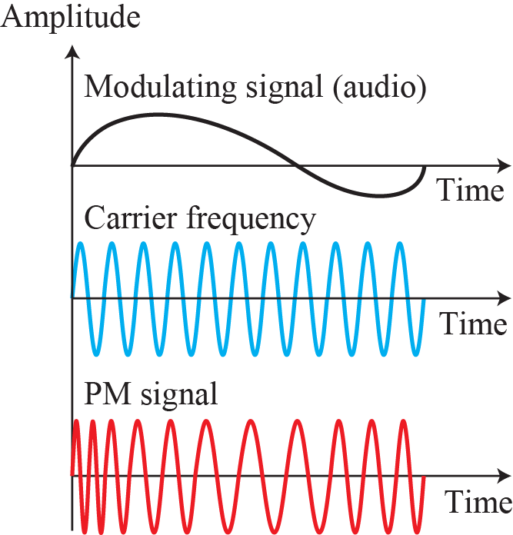
Phase Modulation (PM)

Slide 16
Multiplexing
Multiplexing is the set of techniques that allows the simultaneous transmission of multiple signals across a single data link.
As data and telecommunications use increases, so does traffic. We can accommodate this increase by continuing to add individual links each time a new channel is needed, or we can install higher-bandwidth links and use each to carry multiple signals.

Slide 17
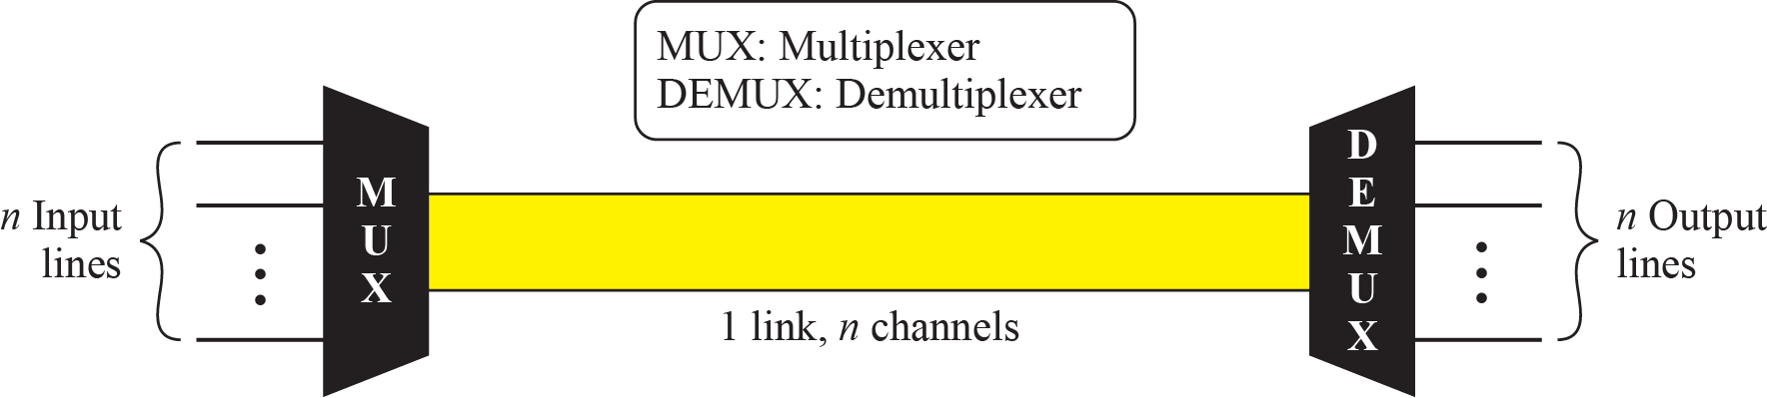
Multiplexing
Figure 6.1: Dividing a link into channels

Slide 18
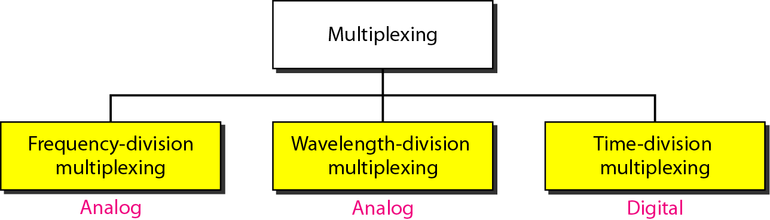
Multiplexing
Figure 6.2: Categories of multiplexing

Slide 19
Frequency-Division Multiplexing
Frequency-division multiplexing (FDM) is an analog technique that can be applied when the bandwidth of a link (in hertz) is greater than the combined bandwidths of the signals to be transmitted.
In FDM, signals generated by each sending device modulate different carrier frequencies.
These modulated signals are then combined into a single composite signal that can be transported by the link.

Slide 20
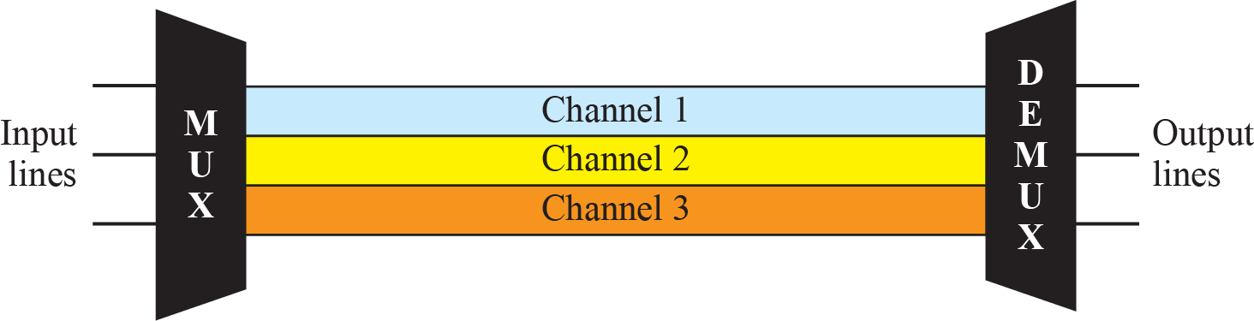
Frequency-Division Multiplexing

Slide 21
FDM Process
Figure 6.4 is a conceptual illustration of the multiplexing process.
Each source generates a signal of a similar frequency range.
Inside the multiplexer, these similar signals modulate different carrier frequencies ( f1, f2, and f3).
The resulting modulated signals are then combined into a single composite signal that is sent out over a media link that has enough bandwidth to accommodate it.

Slide 22
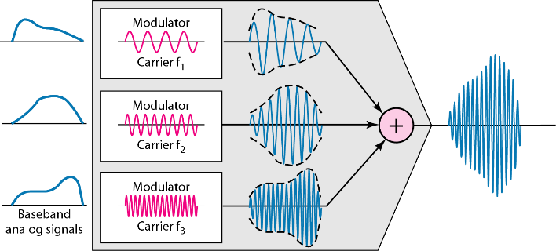
FDM Process
Figure 6.4: FDM Process

Slide 23
FDM Demultiplexing
The demultiplexer uses a series of filters to decompose the multiplexed signal into its constituent component signals.
The individual signals are then passed to a demodulator that separates them from their carriers and passes them to the output lines.
Figure 6.5 is a conceptual illustration of demultiplexing process.

Slide 24
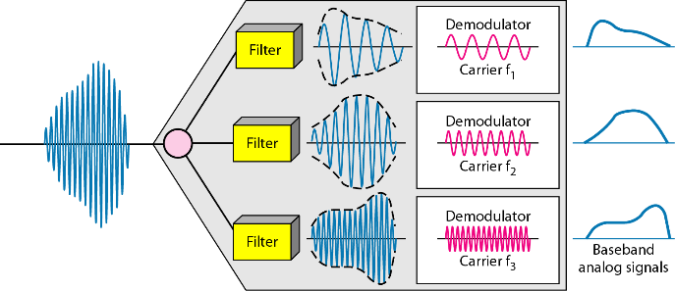
FDM Demultiplexing
Figure 6.5: FDM demultiplexing example

Slide 25
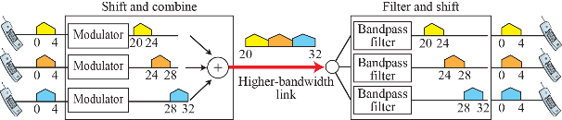
Frequency-Division Multiplexing
Example 6.1: Assume that a voice channel occupies a bandwidth of 4 kHz. We need to combine three voice channels into a link with a bandwidth of 12 kHz, from 20 to 32 kHz. Show the configuration, using the frequency domain. Assume there are no guard bands.
Solution: We shift (modulate) each of the three voice channels to a different bandwidth, as shown in the figure,

Slide 26
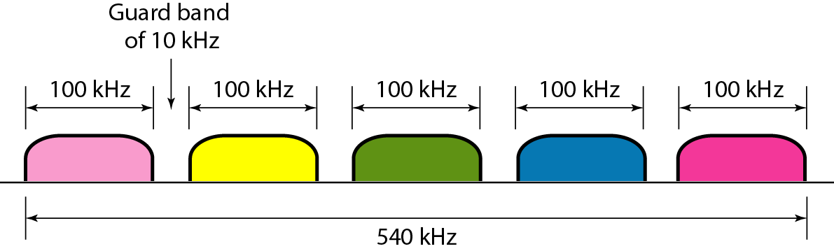
Frequency-Division Multiplexing
Example 6.1: Five channels, each with a 100-kHz bandwidth, are to be multiplexed together. What is the minimum bandwidth of the link if there is a need for a guard band of 10 kHz between the channels to prevent interference?
Solution: For five channels, we need at least four guard bands. This means that the required bandwidth is at least 5 × 100 + 4 × 10 = 540 kHz, as shown in the figure.

Slide 27
Frequency-Division Multiplexing
Example 6.1: Four data channels (digital), each transmitting at 1 Mbps, use a satellite channel of 1 MHz. Design an appropriate configuration, using FDM.
Solution: The satellite channel is analog. We divide it into four channels, each channel having a 250-kHz bandwidth. Each digital channel of 1 Mbps is modulated so that each 4 bits is modulated to 1 Hz. One solution is 16-QAM modulation. Figure 6.8 shows one possible configuration.

Slide 28
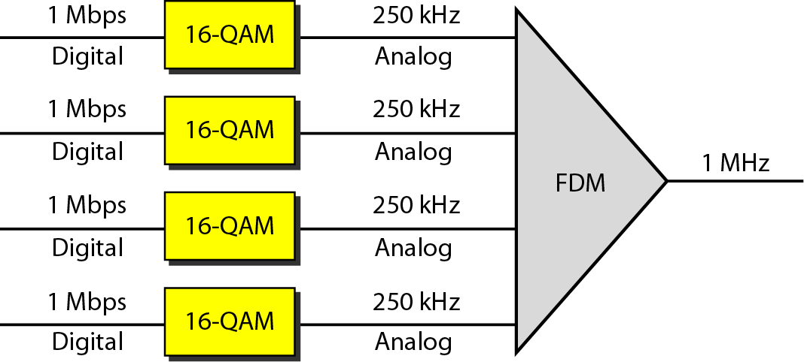
Frequency-Division Multiplexing
Figure 6.8: Example 6.3

Slide 29
Analog Hierarchy
To maximize the efficiency of their infrastructure, telephone companies have traditionally
multiplexed signals from lower-bandwidth lines onto higher-bandwidth lines.
In this way, many switched or leased lines can be combined into fewer but bigger channels. For analog lines, FDM is used.
One of these hierarchical systems used by telephone companies is made up of
groups, supergroups, master groups, and jumbo groups (see Figure 6.9).

Slide 30
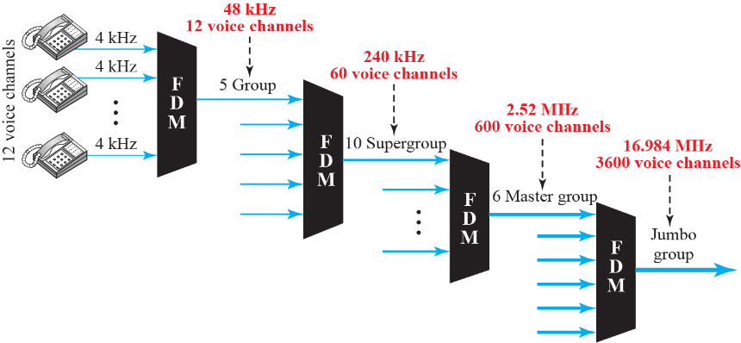
Analog Hierarchy
Figure 6.9: Analog hierarchy

Slide 31
Analog Hierarchy
In this analog hierarchy, 12 voice channels are multiplexed onto a higher-bandwidth line to create a group. A group has 48 kHz of bandwidth and supports 12 voice channels.
At the next level, up to five groups can be multiplexed to create a composite signal called a supergroup. A supergroup has a bandwidth of 240 kHz and supports up to 60 voice channels. Supergroups can be made up of either five groups or 60 independent
voice channels.

Slide 32
Analog Hierarchy
At the next level, 10 supergroups are multiplexed to create a master group. A master group must have 2.40 MHz of bandwidth, but the need for guard bands between the supergroups increases the necessary bandwidth to 2.52 MHz. Master groups support up to 600 voice channels.
Finally, six master groups can be combined into a jumbo group. A jumbo group must have 15.12 MHz (6 × 2.52 MHz) but is augmented to 16.984 MHz to allow for
guard bands between the master groups.

Slide 33
Books
[1] Forouzan AB. Data communications & networking.
5th ed., Tata McGraw-Hill Education.

Slide 34
References
1. Prakash C. Gupta, “Data communications”, Prentice Hall India Pvt.
2. William Stallings, "Data and Computer Communications”, Pearson
3. Forouzan, B. A. "Data Communication and Networking. Tata McGraw." (2005).

